Slide 1

Snowflake Architectures
Suddhasatwa Mallik
May 2021

Slide 2
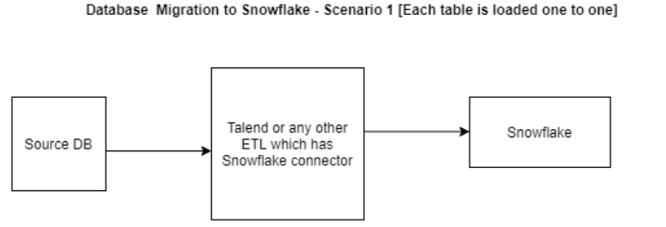
Migrate On Prem database to Snowflake

Slide 3
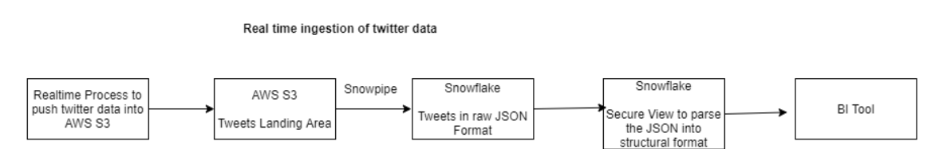
Real time ingestion of twitter data

Slide 4
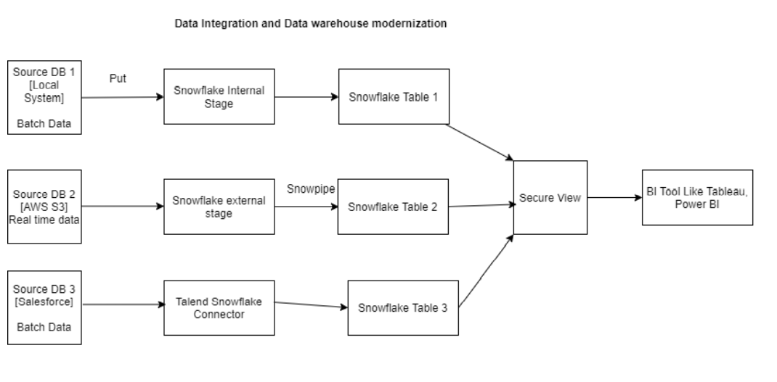
Data Integration and Datawarehouse modernization

Slide 5
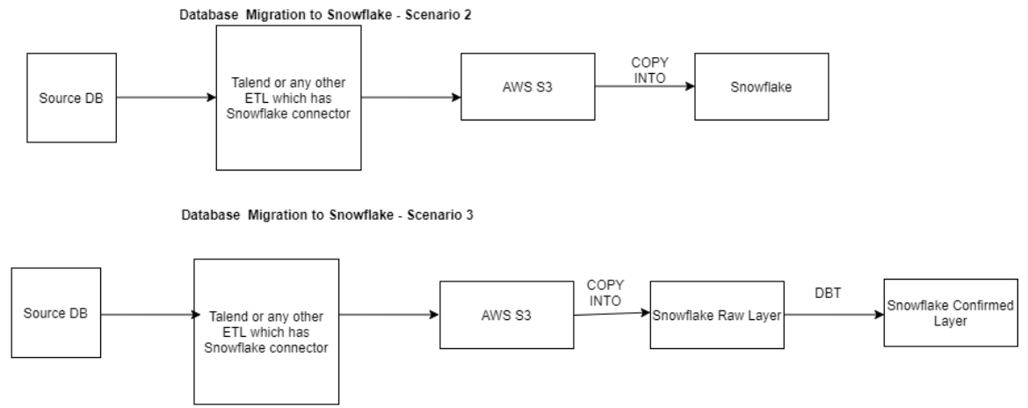
Database migration

Slide 6
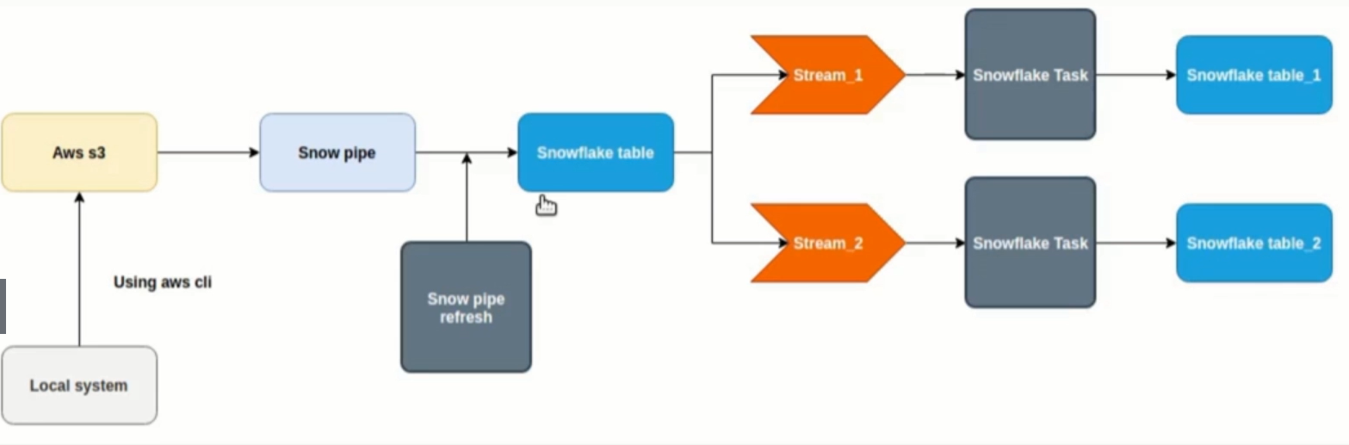
Architecture for Continuous Data Load

